Slide 1


Practical Fully Secure Three-Party Computation via Sublinear Distributed Zero-knowledge Proofs
Supervisor: Dr Niv Gilboa
Vitali Lopushenko Osher Saragani

Slide 2


Team
Members
Vitali Lopushenko
Osher Saragani

Slide 3
Who is the richest?
Millionaire A
Millionaire B
Millionaire C
X
Y
Z
It’s a simple function: MAX(X,Y, Z).
BUT no one want to revile how much money he has (you know, IRS…)
How can we calculate a joint function without revile the inputs?
How can anyone can be sure the other Parties didn’t lie in the process of calculating the joint function?
03

Slide 4
MPC Applications
MPC
Block
Chain
Secure Election
Bench-marking
Machine
Learning
Notes:
Benchmarking: One immediate application is benchmarking. Companies may wish to com-pare themselves to the industry standard, but none are motivated to share their data, which may contain trade secrets.
DATA Centers:
MPC enables multiple parties to perform analyses on private datasets without sharing them with each other. Or request data from database without reviling nothing to the servers.
BlockChain:
In this system, users run a multi-party computation to output a randomized function which takes private inputs from users and returns a ‘witness encryption’ cipher-text. This means each user has the encrypted result of the computation, but needs to decrypt it.
To access the cipher-text, each user needs to generate (using cryptography) and publicly post a ‘release token’ on the ledger. Once a user posts their release token, corresponding proof of posting the release token is also published on the ledger. This proof is called the ‘witness’. The witness can then be used to decrypt the cipher-text and obtain the result of the multi-party computation. To ensure that everyone can view the result simultaneously, the result of the computation should be posted on a public blockchain at a specified time.

Slide 5
01
Connectivity
The
Phases
Of the
Program
Connect all the parties with an TCP connection
02
Secret Sharing
Share each Party input to other parties
without reviling the actual input
03
Circuit C
Calculate joint function
04
Verification
Verify that all the part of the function calculated correctly by the parties (check there is no corrupted party)

Slide 6



Connectivity
$$p_{1}$$
Msg Type:
“msg”
10001010
110110010
1100101001100
Verify that the message according the protocol
$$p_{2}$$
$$p_{3}$$
03
Notes:
Connectivity:
There is TCP socket base class and TCP client and TCP server classes – same code for all parties.
We implemented the sockets with threads for better performance.
Massage handler – check if the that arrived is one of the protocol massage – abort if not.
*header, *size, *stage

Slide 7





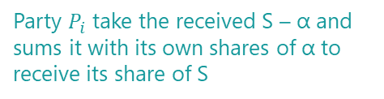
Secret Sharing
7
1
2
3
4
5
Each Party $P_{i}$ calculate its share
Party $P_{i}$ take the received S – α and sums it with its own shares of α to receive its share of S
Reconstruct on α
and broadcast S - α.
Calculate AES on SEQ with The keys $k_{i−1},k_{i}$
$a_{i}=AES_{k_{i}}\left(SEQ\right)$,$a_{i−1}=AES_{k_{i}−1}\left(SEQ\right)$.
Generate random number K
Send the number to P+1, now each party has another two numbers $k_{i−1},k_{i}$
Calculate SEQ
$$SEQ=SEQ_{i−1}+SEQ_{i}+SEQ_{i+1}$$
Generate random number and Broadcast to all
Each party generate random number: $SEQ_{i}$ and broadcast to other parties

Slide 8


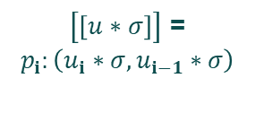
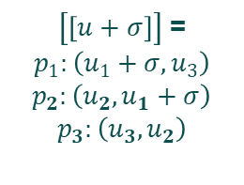


Operations
Constant
+
Share
Share
+
Share
Constant
Share
Share
Share
$\left[\left[u+σ\right]\right]$ = $p_{1}:\left(u_{1}+σ,u_{3}\right)$ $p_{2}:\left(u_{2},u_{1}+σ\right)$ $p_{3}:\left(u_{3},u_{2}\right)$
$\left[\left[u\right]\right]+\left[\left[v\right]\right]$ = $\left(u_{i}+v_{i}, u_{i−1}+v_{i−1}\right)$
$\left[\left[u∗σ\right]\right]$ = $p_{i}:\left(u_{i}∗σ,u_{i−1}∗σ\right)$
$$requires$$
$$communication$$

Slide 9



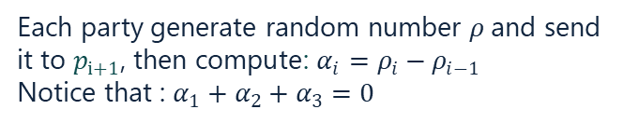

Multiplication Gate
Correlated randomness
Each party generate random number $ρ$and send it to $p_{i+1}\text{, }\text{then} \text{compute}$: $α_{i}=ρ_{i}−ρ_{i−1}$
Notice that : $α_{1}+α_{2}+α_{3}=0$
Calculate
$$z_{i}=u_{i}⋅v_{i}+u_{i}⋅v_{i−1}+u_{\dot{l}−1}⋅ν_{i}+α_{i}$$
Send to $P_{i+1}$
Store output
Store the output of the gate as:
$$\left(z_{i},z_{i−1}\right)$$

Slide 10





Circuit C
Level $ⅈ$
Level $ⅈ+1$
Any computable function can be represented as an arithmetic Addition/Multiplication gates.
Each party have a copy of the C circuit.
The circuit calculated level by level.
The parties synchronize each multiplication gate.
Each party stores all the Multiplication gates output in a vector for verification phase.
C

Slide 11
Verification Phase
Verification Correctness of messages in the Multiplication Gates protocol.
This functionality checks that is no corrupted party by checking all the inputs from other parties to the Multiplication gates.
This stage is necessary before reconstructing the output of the C circuit.
Each party is a verifier and required to send all the inputs and outputs of the multiplication gates.

Slide 12

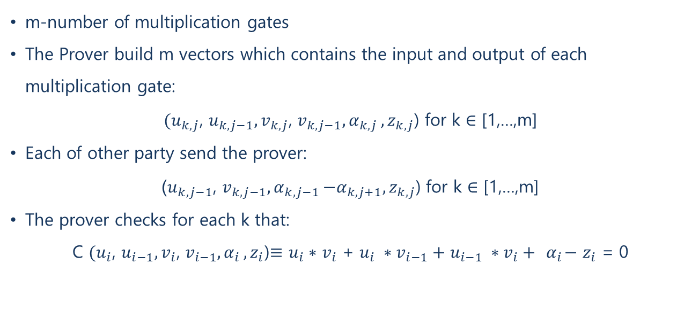

Verification Process
m-number of multiplication gates
The Prover build m vectors which contains the input and output of each multiplication gate:
${(u}_{k,j}$, $u_{k,j−1},v_{k,j}$, $v_{k,j−1}{, α}_{k,j},z_{k,j}$) for k $∈$ [1,…,m]
Each of other party send the prover:
($u_{k,j−1}$, $v_{k,j−1}{, α}_{k,j−1}−α_{k,j+1},z_{k,j}$) for k $∈$ [1,…,m]
The prover checks for each k that:
C ${(u}_{i}$, $u_{i−1},v_{i}$, $v_{i−1}{, α}_{i},z_{i}$)$≡$ $u_{i}∗$ $v_{i}$ + $u_{i} ∗v_{i−1}+u_{i−1} ∗v_{i}+ { α}_{i}−$ $z_{i}$ = 0
$$?$$
$$z_{i}=u_{i}⋅v_{i}+u_{i}⋅v_{i−1}+u_{\dot{l}−1}⋅ν_{i}+α_{i}$$

Slide 13
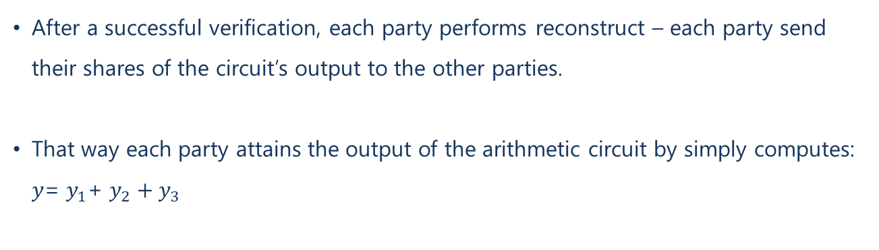
Finally…
reconstruct
After a successful verification, each party performs reconstruct – each party send their shares of the circuit’s output to the other parties.
That way each party attains the output of the arithmetic circuit by simply computes: $y$= $y_{1}$+ $y_{2}+y_{3}$

Slide 14
Security
An adversary can not infer any information about the inputs of the other parties.
An adversary can not learn any further information about the protocol which is not public knowledge.
The “wildest” act a malicious party can perform is to stop the execution of the protocol.

Slide 15
Thank you!
Questions?

